Slide 1
Jak na vlastní code analyzery What are code analyzers and how to write your own
Ondřej Václavek
Software engineer, HAVIT, s.r.o. vaclavek@havit.cz

Slide 2
Agenda
What are code analyzers?
Roslyn API (docs)
How does it work?
Why would we like to use it?
How to create your own analyzer?

Slide 3
What are code analysers
= „A piece of software providing static analysis of source code for style, quality, maintainability, design, and other known issues“
Static vs dynamic analysis
Syntactic and semantic analysis
Analysis and code fix

Slide 4
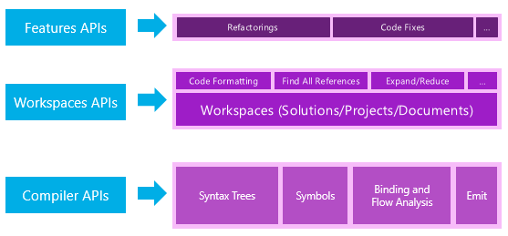
Roslyn API layers

Slide 5
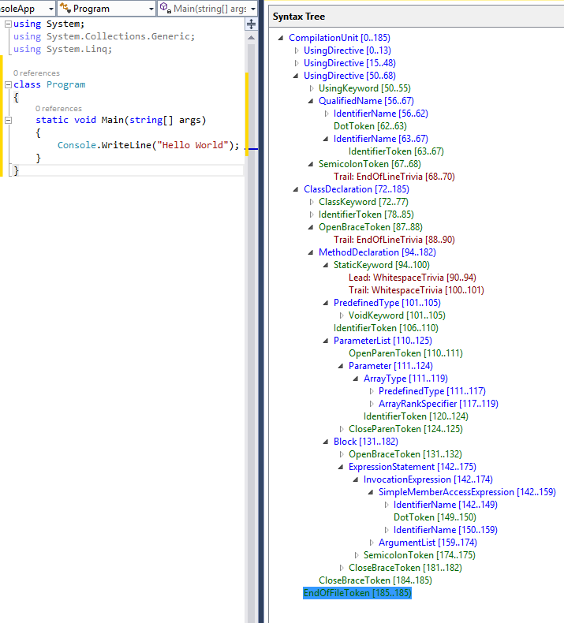
Syntactic analysis (docs)
Parse to Immutable Syntax Tree
Tree / Node / Token / Trivia
Structural information about code
Every information in code has its representation in syntax tree
Convertible in both directions
Very fast

Slide 6
DEMO – Syntactic analysis

Slide 7
Semantic analysis (docs)
Adds meaning to syntax trees
Can answer questions like:
What names are used in current scope?
What members are accessible from this method?
What variables are used in this block of text?
What does this name/expression refer to?
...
Semantic model is „Superset“ of syntax tree
Symbols – entities that code refer to (string, int …)
Bindings – process of associating names and expressions with Symbols
Code flow – inaccesible parts of code etc.

Slide 8
DEMO – Semantic analysis

Slide 9
Syntactic tree transformation (docs)
Syntactic tree is immutable
How to solve transformations? With replacing nodes
How to replace nodes?
Factory methods (change just a few specific nodes or locations)
Rewriting (scan entire project for code patterns and fix them)

Slide 10
DEMO – transformation

Slide 11
Now (finally) Code Analyzers
VS Template „Analyzer with Code Fix“
Can be debugged as Vsix extension in new instance of VS
Published via Vsix, dll or nuget
part of project
build fails if error triggers (not with Vsix extension)
works also in VS Code, Rider

Slide 12
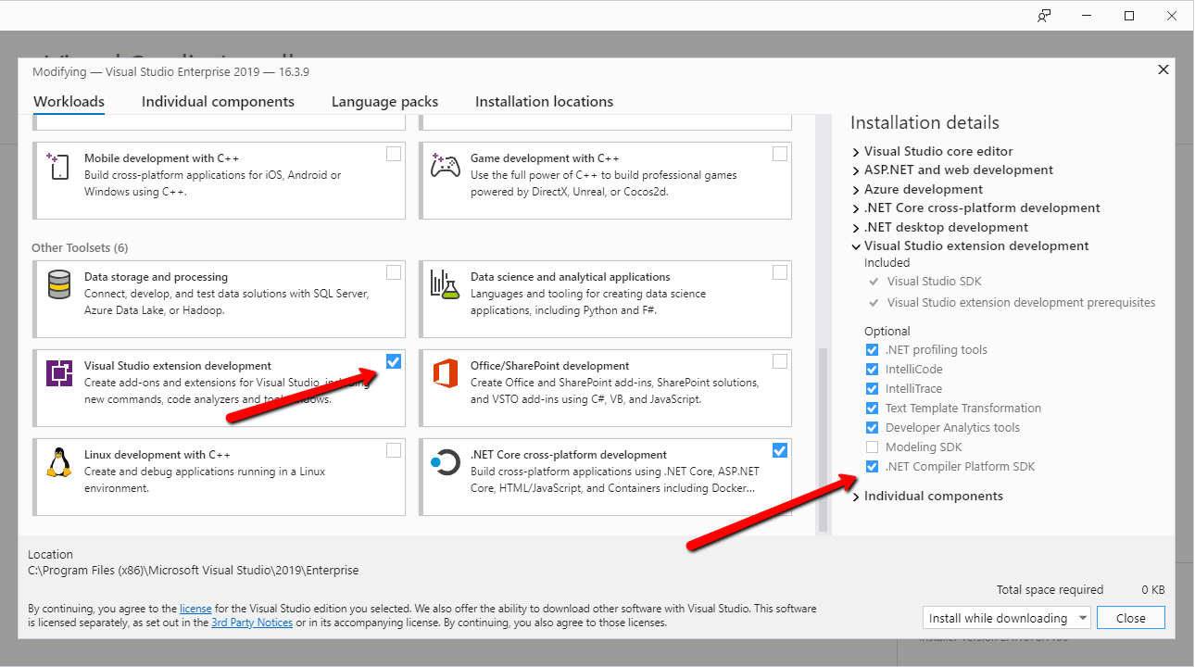
Now (finally) Code Analyzers

Slide 13
DEMO – Code analyzer

Slide 14
Děkuji!

